Slide 1
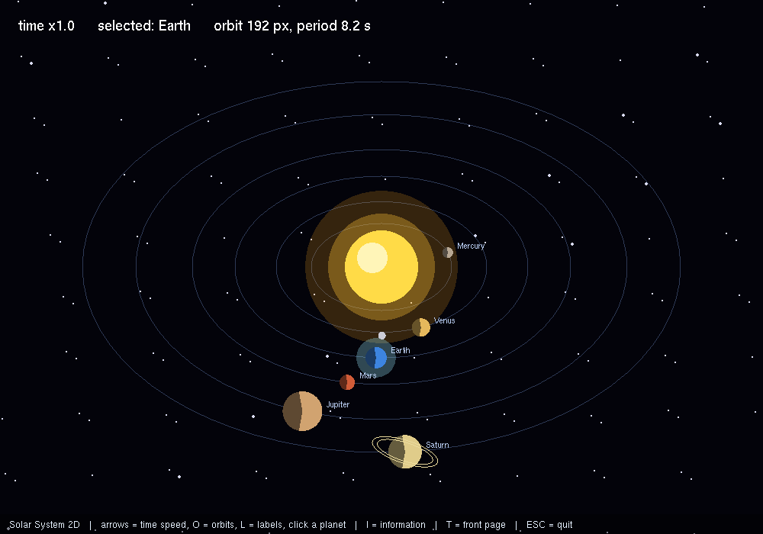
Basic Solar System 2D
2D OpenGL Mini Project in C · 639 lines · freeglut
Computer Graphics Laboratory with Mini Project · Copyright (c) 2026 Suman Hugar

Slide 2
Introduction
Basic Solar System 2D is a 2D computer graphics mini project written in C using the OpenGL fixed-function pipeline and GLUT.
It is 639 lines of source in a single file, with no model files, image files or other external assets. Everything on screen is generated in code from OpenGL primitives.

Slide 3
Objectives
• Implement a complete 2D scene using OpenGL and GLUT
• Apply translation, rotation and scaling through the modelview matrix
• Demonstrate hierarchical modelling with the matrix stack
• Produce flicker-free animation with double buffering
• Respond to user input through GLUT event callbacks

Slide 4
System Requirements
Component | Requirement
Language | C
Graphics API | OpenGL 1.x fixed-function
Toolkit | freeglut (GLUT) 3.x
Compiler | gcc / g++, MinGW-w64 on Windows
Platform | Linux and Windows

Slide 5
Architecture
• main() creates the window, sets one-time GL state and registers callbacks
• glutMainLoop() takes control; the program runs only through its callbacks
• display() draws one frame and changes no state
• A timer or idle callback advances the animation and posts a redisplay
• Keyboard callbacks update state; they never draw
• reshape() recomputes the viewport and projection on resize

Slide 6
Hierarchical Modelling and the Matrix Stack
The scene is not drawn as a flat list of shapes at absolute positions. Parts are drawn inside the coordinate space of the part they belong to, so a component automatically follows whatever it is attached to. This is what the modelview matrix stack is for.
glPushMatrix saves a copy of the current transformation matrix; the code then applies its own translation, rotation or scale and draws the child; glPopMatrix restores the saved matrix so the next sibling starts from the parent's state again. Because transformations compose by matrix multiplication, a child inherits every transformation applied by its ancestors without any explicit arithmetic.

Slide 7
Alpha Blending and Transparency
Blending combines the fragment being drawn with the colour already in the framebuffer instead of replacing it. With the usual function, glBlendFunc(GL_SRC_ALPHA, GL_ONE_MINUS_SRC_ALPHA), the incoming colour is weighted by its alpha and the existing colour by one minus that alpha, so a surface at 30% alpha lets 70% of what is behind it through.
Blending is order-dependent in a way that opaque drawing is not. Transparent geometry has to be drawn after the opaque geometry, and ideally back to front, because the depth test will otherwise reject fragments that should have contributed to the blend.

Slide 8
Viewing, Projection and the Camera
Getting an image out of a 3D scene takes two matrices. The modelview matrix places objects relative to the eye, and the projection matrix decides how that eye space is flattened onto the screen. They are configured separately, selected with glMatrixMode.
gluPerspective sets up a perspective projection from a field of view, an aspect ratio and near and far clipping planes; distant objects get smaller, which is what makes a scene read as three-dimensional. glOrtho and gluOrtho2D set up a parallel projection where size does not change with distance, which is the right choice for 2D work and for overlays.

Slide 9
Animation and the Frame Loop
Animation is a state update repeated between frames. GLUT drives this either with glutTimerFunc, which asks for a callback after a stated number of milliseconds, or with glutIdleFunc, which runs whenever no events are pending. The callback advances the state and calls glutPostRedisplay to request a new frame.
Double buffering is what makes the result look continuous. The frame is composed in a back buffer that the display never shows, and glutSwapBuffers presents it in one step. Drawing straight to the visible buffer instead produces tearing and flicker, because the viewer sees the image being assembled.

Slide 10
Geometry and Primitives
• Primitives used: lines, line loops, triangle fans, quads
• 4 glPushMatrix / glPopMatrix pairs build the scene hierarchy
• No circle primitive exists in OpenGL — round shapes are triangle fans stepped with sine and cosine

Slide 11
Controls
Key | Action
ENTER, or a left click | START PROJECT on the title page
I or F1 | the project information page, on and off
ESC | close the information page, or quit
T | go back to the front page
RIGHT / LEFT | speed up or slow down time
O | orbit rings on / off
L | labels on / off
Click a planet | select it and read its detail
P | pause

Slide 12
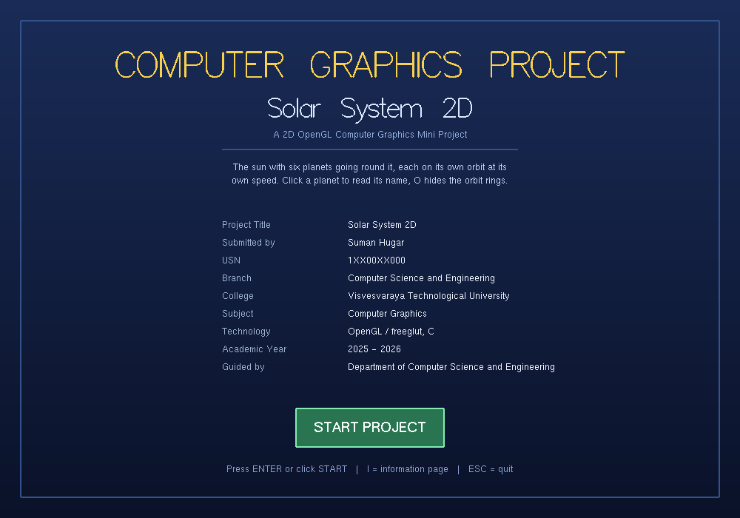
Title Page
Basic Solar System 2D — the first page, with the project and student detail

Slide 13
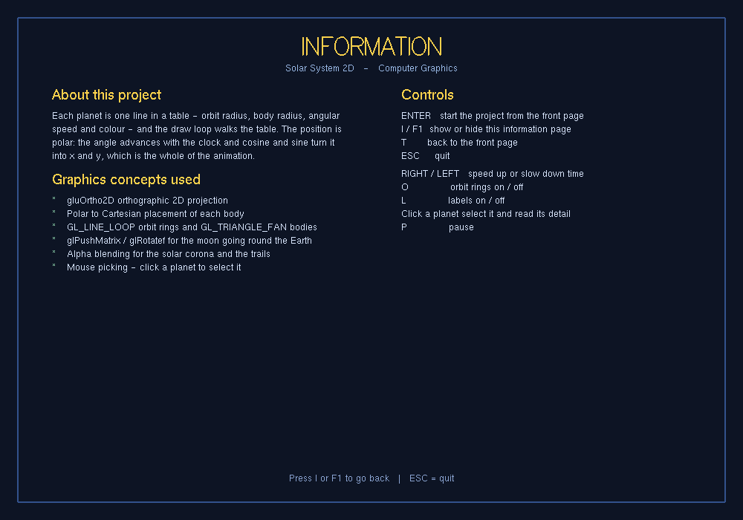
Project Information
Basic Solar System 2D — what it does, the concepts it uses, every control

Slide 14
Output
Basic Solar System 2D — captured from the running program

Slide 15
Viva Questions
Q. What do glPushMatrix and glPopMatrix do?
They save and restore the current transformation matrix. Push takes a copy so the matrix can be modified freely for one object, and pop discards the modified copy and puts back what was there. Without them, every transformation would accumulate into everything drawn afterwards.
Q. Why does the order of glTranslate and glRotate matter?
Because matrix multiplication is not commutative. Translating then rotating turns the object about its own new origin; rotating then translating swings it around the old origin on the end of a lever. Both are legal and they give completely different results.

Slide 16
Viva Questions (cont.)
Q. How is hierarchical modelling demonstrated in this project?
Each moving part is drawn between a push and a pop inside its parent's transformation, so rotating the parent carries the child with it automatically.
Q. What is alpha blending?
Combining a new fragment with the contents of the framebuffer according to an opacity value, rather than overwriting. The standard function weights the source by its alpha and the destination by one minus alpha.

Slide 17
Limitations and Future Work
• Uses the deprecated fixed-function pipeline; a shader-based port is the modern equivalent
• Geometry is submitted in immediate mode every frame
• No texture mapping — surfaces are solid colours

Slide 18
Conclusion
Basic Solar System 2D implements a complete 2D scene in 639 lines of C with no external assets.
It demonstrates alpha blending, matrix stack (hierarchical modelling), orthographic projection, timer-driven animation.

Slide 19
Thank You
Basic Solar System 2D

